Slide 1

Advance HTML
Final Project
Title: Car Rental
Name: Satnam Singh
Student Id: 3651
30April 2020
1

Slide 2

Advanced HTML
CarRental is best option for those people who want to go out from their home or from any other place for some urgent work and if they are in hurry.
Because it is more safe during current situation.
That is why I selected this topic for my project.
April 2020
1
Title:

Slide 3
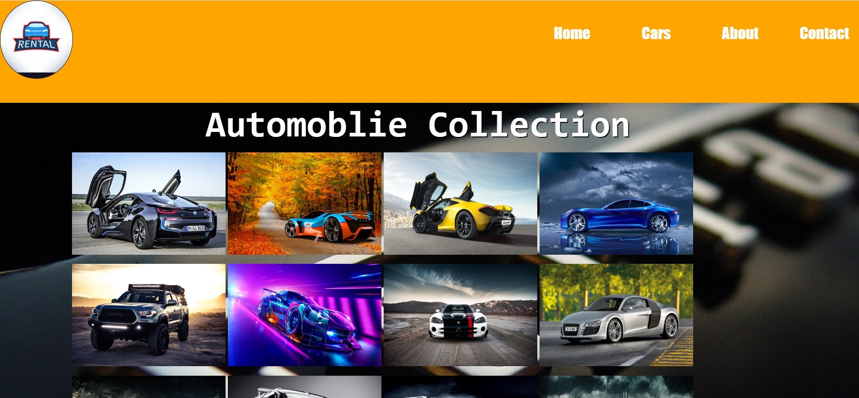
Advanced HTML
Here is Index page of the project.
Each navigation bar has a different bar color.
April 2020
1
Title:

Slide 4
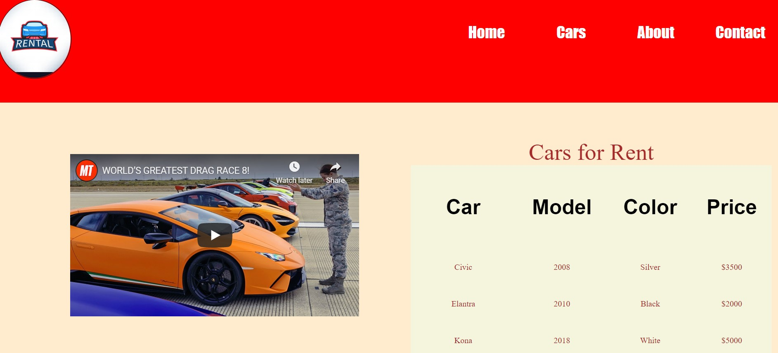
Advanced HTML
It is car detail web page where user can find best car and model according to their
Budget.
They can also choose color whatever they want and like.
There is also car racing video. Users can enjoy this one too.
April 2020
1
Title:

Slide 5
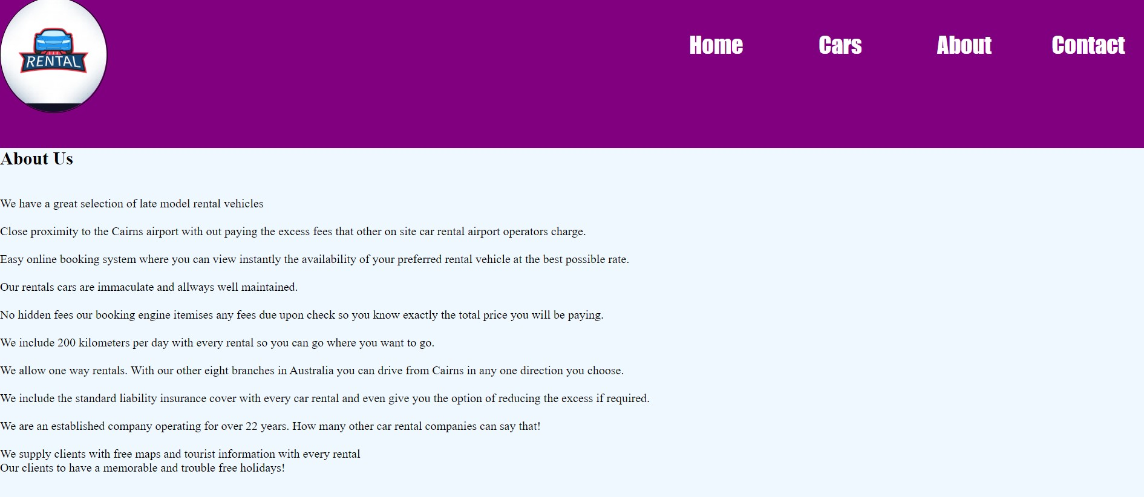
Advanced HTML
On about page users can find the detail of the company.
Like:
When company was established.
By whom etc.
April 2020
1
Title:

Slide 6
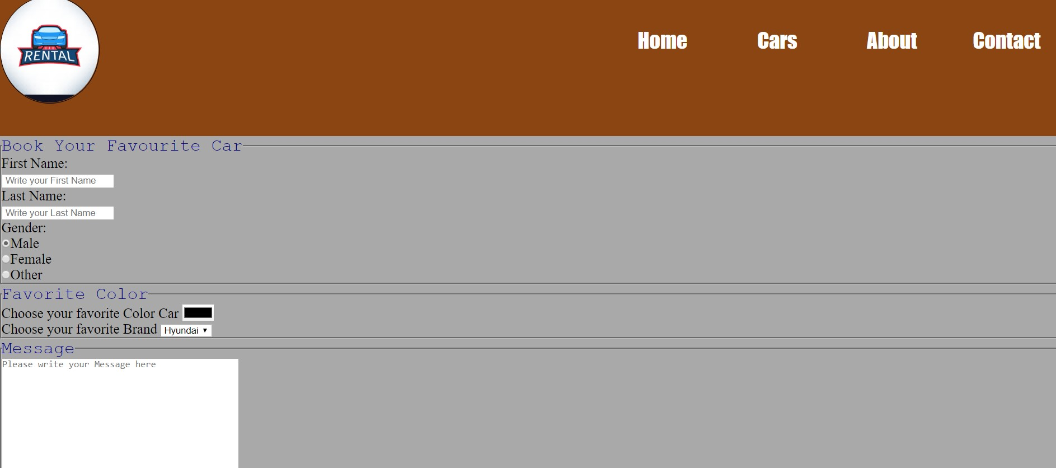
Advanced HTML
Contact Us:
Users can easily contact us by filing a little form.
Then we can proceed their request.
April 2020
1
Title:

Slide 7
Advanced HTML
Thank YOU!
April 2020
1
Title:

